Slide 1

About Node.js

Slide 2
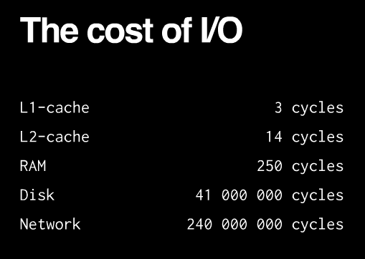
About web server
About node
About ESP

Slide 3
About web server
About node
So the largest waste with current programming technologies comes from waiting for I/O to complete.
About ESP

Slide 4
About web server
About node
1.synchronous:
2.fork a new process:
3.Threads:
About ESP

Slide 5
About web server
About node
1.synchronous:
ServerSocket server = new ServerSocket(9998);
for(;;)
{
Socket incoming = server.accept();
//业务逻辑
}catch (IOException ex){ ex.printStackTrace(); }
About ESP

Slide 6
About web server
About node
2.fork a new process /new thread:
ServerSocket server = new ServerSocket(9998);
for(;;)
{
Socket incoming = server.accept();
//业务逻辑
new ServerThread(incoming,i).start();
}catch (IOException ex){ ex.printStackTrace(); }
About ESP

Slide 7
About web server
About node
2.fork a new process /new thread:
每个连接都会生成一个新线程，每个新线程可能需要 2 MB 的配套内存。在一个拥有 8 GB RAM 的系统上，理论上最大的并发连接数量是 4,000 个用户
About ESP

Slide 8
About web server
About node
How about node.js?
Node.js are not multithreaded, because threads and processes carry a heavy memory cost. They are single-threaded, but event-based. This eliminates the overhead created by thousands of threads/processes by handling many connections in a single thread.
About ESP

Slide 9
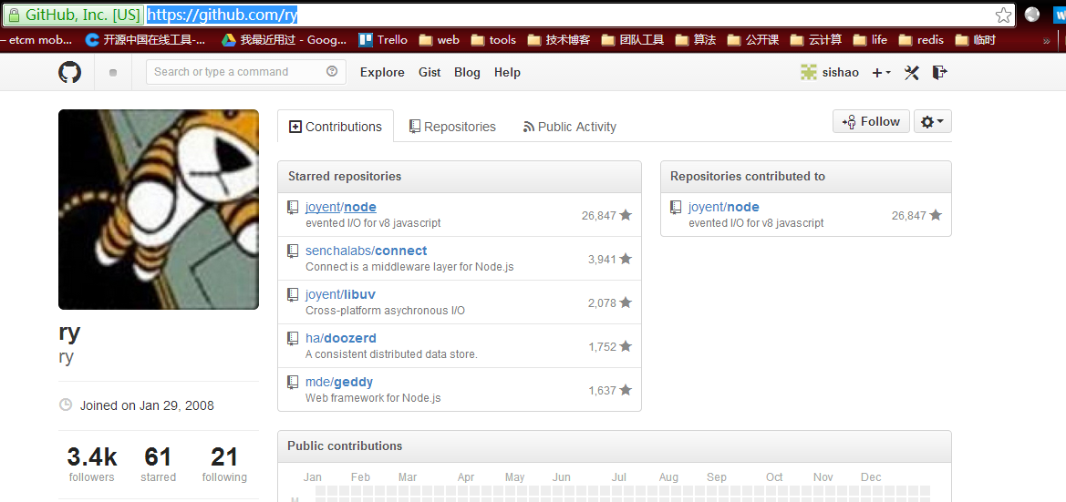

About web server
About node
About ESP

Slide 10
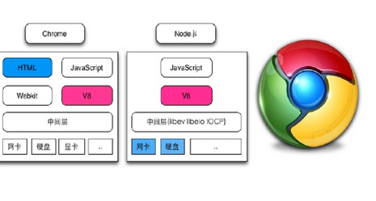
About web server
About node
About ESP

Slide 11
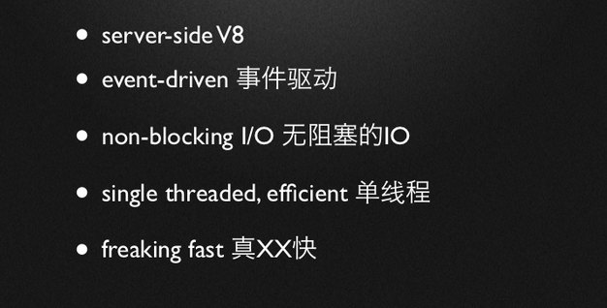
About web server
About node
About ESP

Slide 12
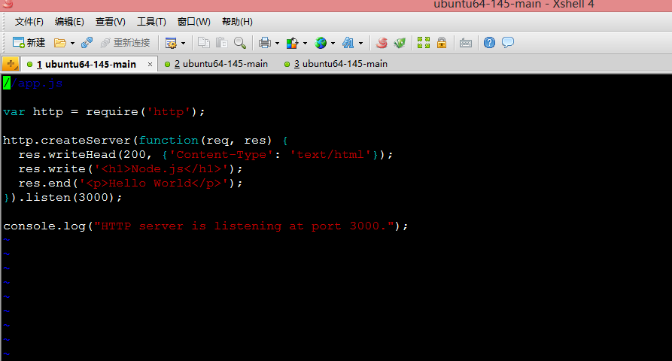
About web server
About node
About ESP

Slide 13
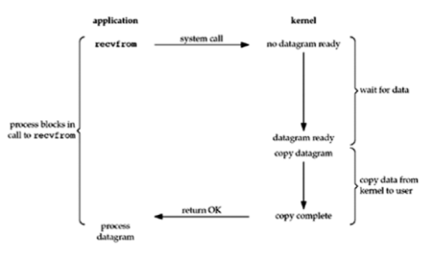
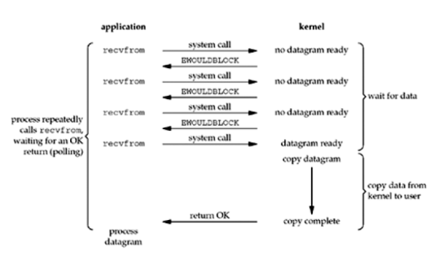
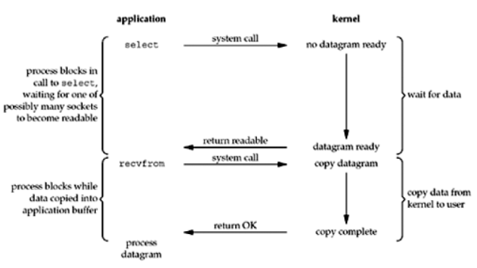
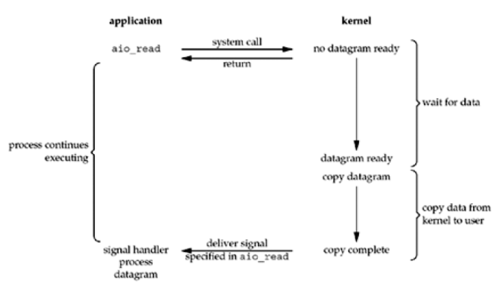
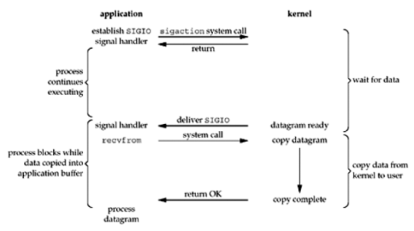
About web server
About node
Blocking I/O Model
Nonblocking I/O Model
Java nio是select模型
About
epoll, kqueue是Reacor模式，IOCP是Proactor模式
I/O multiplexing
signal driven I/O
asynchronous I/O

Slide 14
About web server
About node
Node
Node.js的设计核心：异步I/O、事件驱动
Node.js框架
JS
Node标准库
C/C++
Node下层接口
About ecosystem
Libuv
V8
Chrome的JavaScript引擎
Libeio
Libev
IOCP
POSIX系统的epool或kqueue
Windows的IOCP机制

Slide 15
About web server
About node
Libev/libuv事件循环机制
About ecosystem

Slide 16
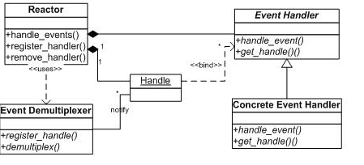
About web server
About node
About ecosystem

Slide 17
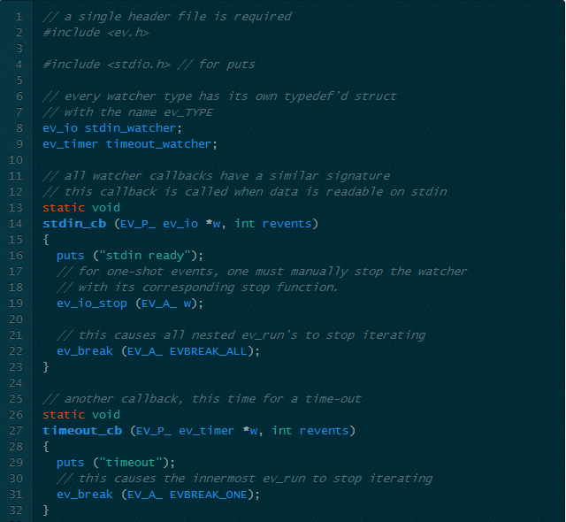
About web server
About node
About ecosystem

Slide 18
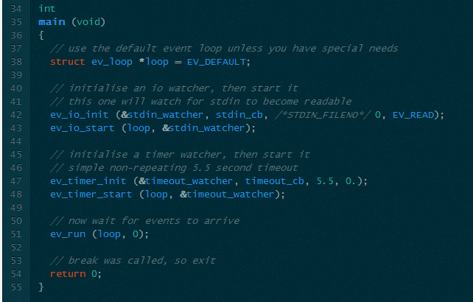
About web server
About node
About ecosystem

Slide 19
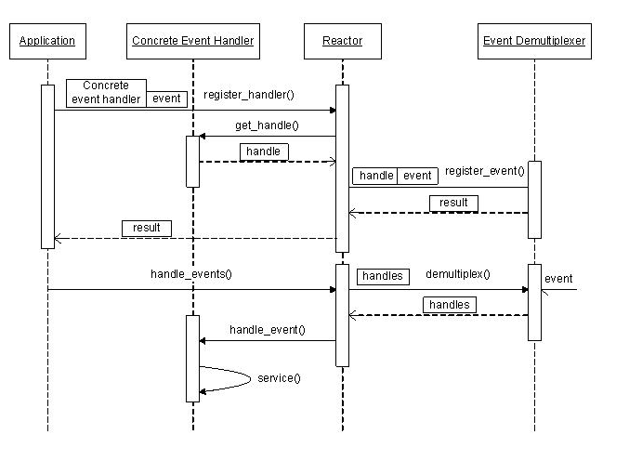
About web server
About node
About ecosystem

Slide 20
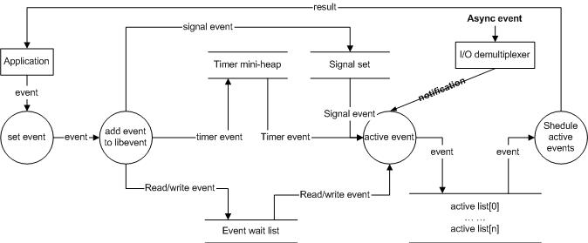
About web server
About node
About ecosystem

Slide 21
About web server
About node
实例 | Libev/libuv | Reactor pattern
io, timer, signal | watcher | handler
 | evloop | reactor
 | ev_run | Event demultiplexer
About ecosystem

Slide 22
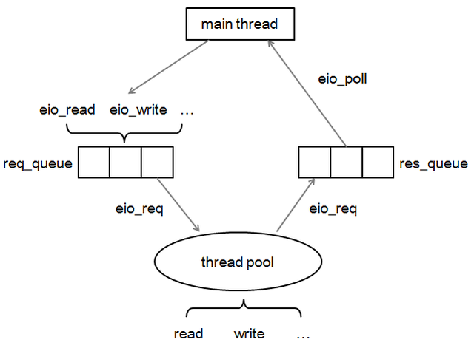
About web server
About node
About ecosystem

Slide 23
About web server
About node
Node的异步I/O和事件机制
1
resource.json
Event Loop
waiting
4
$.post(‘/resource.json’, function(data){
console.log(data);
})
About ecosystem
1. Ajax request made for "resource.json“
2. User clicks, "onclick" event handled
3. Another Ajax response comes back
4. Finally, Ajax response for "resource.json"
comes back and is handled in the callback
3
2
Another Ajax reponse
User interaction – “Onclick”

Slide 24
About Node
About node
Node – 异步编程技巧
两种策略：回调、事件监听
回调通常用来处理“一次性”的响应，比如查询DB，用回调函数来处理
数据库查询的返回结果
事件监听，Node的events模块允许自定义“EventEmitter”，增加需要
监听的事件类型，相应事件能够触发响应逻辑。
About ecosystem

Slide 25
About Node
About EventEmitter
自定义事件
相当于java里的import
var EventEmitter = require("events").EventEmitter;
var ee = new EventEmitter();
ee.on("someEvent", function (){
console.log("event has occured");
});
ee.emit("someEvent");
About ecosystem
当事件someEvent到达时
发送事件

Slide 26
About Node
About Http
Http服务器解析
相当于java里的import
var http = require('http');
var server = new http.Server();
server.on('request', function(req, res) {
res.writeHead(200, {'Content-Type': 'text/html'});
res.write('<h1>Node.js</h1>');
res.end('<p>Hello World</p>');
});
server.listen(3000);
console.log("HTTP server is listening at port 3000.");
继承自EventEmitter
About ecosystem
当客户端请求到来时，
事件被触发

Slide 27

About Node
About Node
Node的几点缺陷：
不支持故障恢复
一旦出现bug，整个系统就奔溃了
2. 没有日志
3. 无法利用多核来提高性能
4. 独占端口
5. 需要手动启动
About ecosystem
Node的用武之地：
数据密集型
实时应用
…学习中

Slide 28
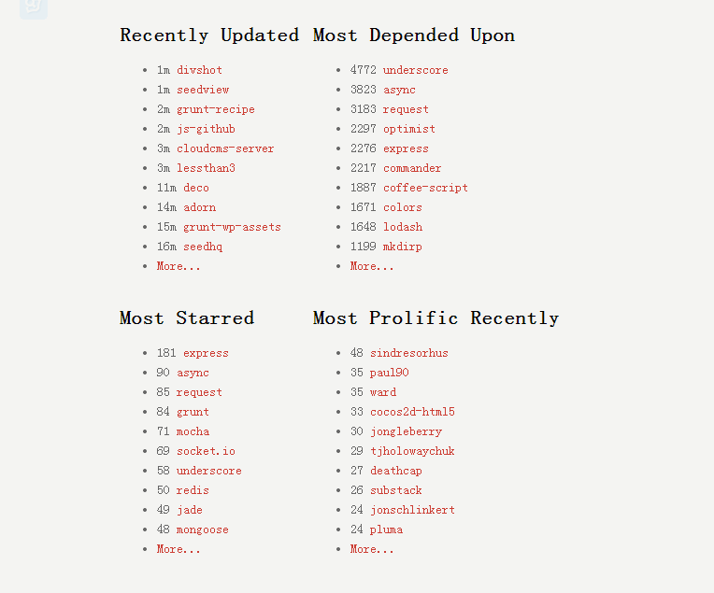
About Node
About Node
About ecosystem

Slide 29
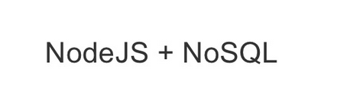
About Node
About Node
About ecosystem

Slide 30
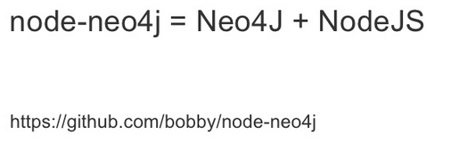
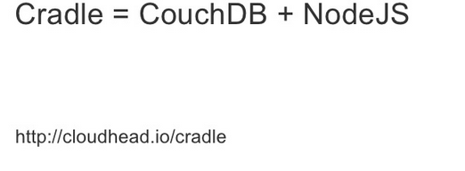
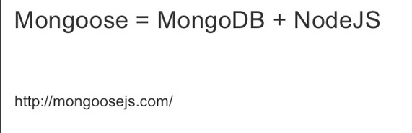
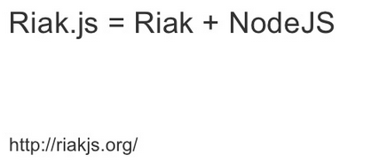
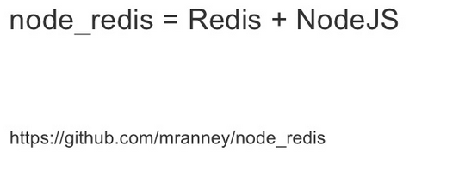
About Node
About Node
About ecosystem

Slide 31
About Node
About Node
Q?
About ecosystem

